Slide 1
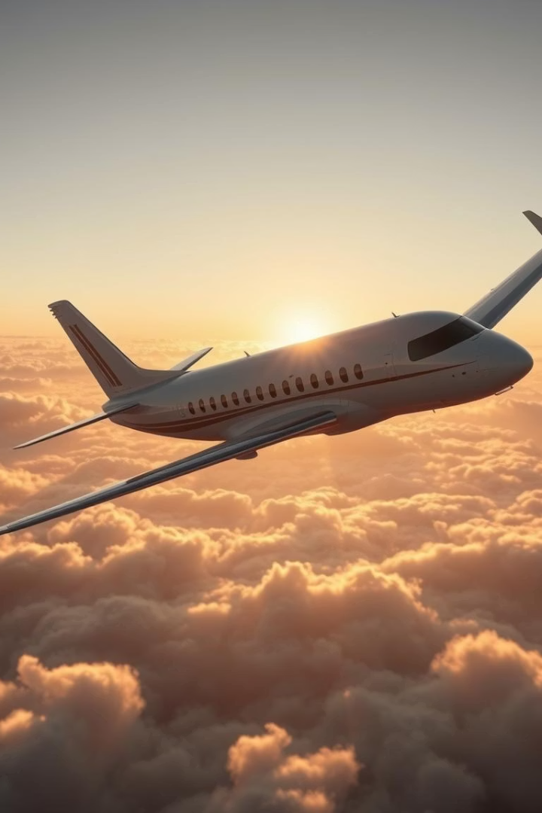
Code Crushers Airline Passenger Satisfaction Project
Air travel is essential for many, and airlines strive to ensure passenger satisfaction to retain customers. This project aims to predict airline passenger satisfaction using data analytics. Understanding key factors helps airlines improve services and customer experience.
BY:CODE CRUSHERS

Slide 2
Dataset Overview and Passenger Information
The dataset, sourced from Kaggle, includes 103,904 passengers and 25 variables. It covers demographic details, flight experience ratings, and satisfaction status. This rich data foundation supports comprehensive analysis of passenger satisfaction drivers.
Passenger Count
Variables
Data Source
103,904 passengers included in the dataset
25 features including demographics and flight experience
Kaggle airline passenger satisfaction dataset

Slide 3
Data Preparation Process
Following the CRISP-DM framework, data preparation ensures the dataset is clean and ready for modeling. Key tasks included cleaning, handling missing values, encoding categorical variables, and addressing outliers.
These steps improve data quality and model reliability, enabling accurate predictions of passenger satisfaction.
Missing Values
Encoding
Outliers
Handled using median imputation for arrival delays
Encoding Categorical Variables
Detecting and Binning Outliers
Machine learning models need numeric values. Columns like Gender, Customer Type, Type of Travel, Class, and Satisfaction were encoded using Label Encoding. This method was chosen because the values had a logical order or binary structure.
Outliers were found in 'Flight Distance', 'Departure Delay in Minutes', and 'Arrival Delay in Minutes'. Instead of removing them (which would reduce data size), we applied binning to simplify and smooth the data. For example, 'Flight Distance' was categorized into 'Short', 'Medium', and 'Long'. Delay columns were grouped into 'On Time', 'Moderate Delay', and 'High Delay'.
Dropping Irrelevant Columns
Columns like 'id' and 'Unnamed: 0' do not help in analysis or prediction. These were removed to avoid unnecessary noise in the data.

Slide 4

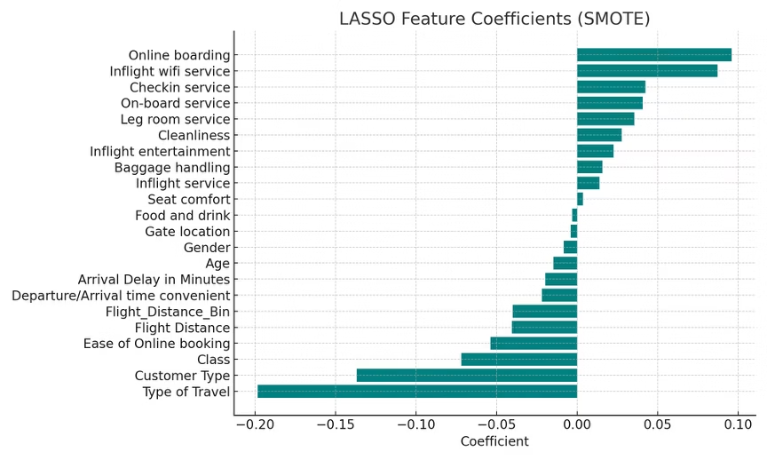
Feature Importance Insights
LASSO identified key features impacting passenger satisfaction by assigning coefficients. Non-zero coefficients indicate significant features, such as Customer Type, Type of Travel, Online Boarding, and Inflight Wifi Service.
Understanding these features helps tailor improvements to enhance satisfaction effectively.

Slide 5
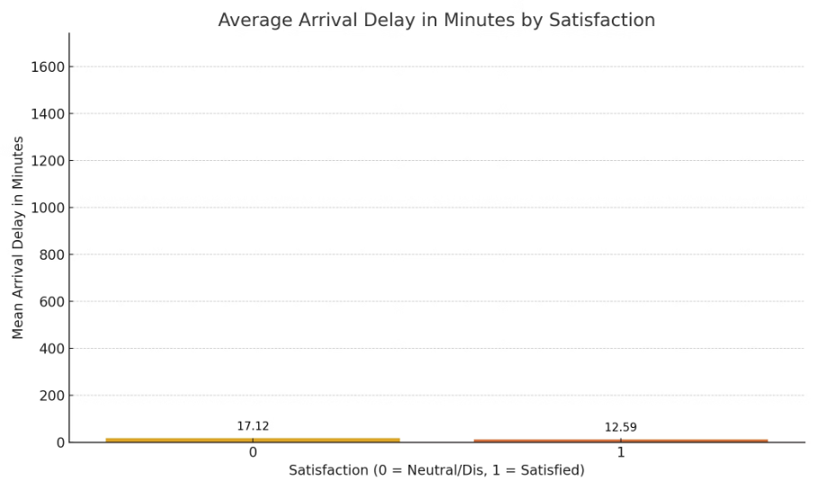
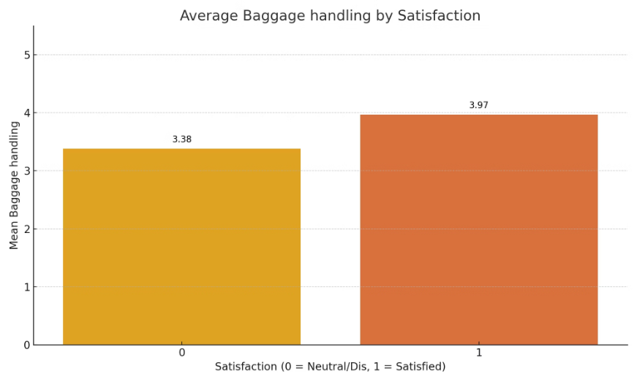
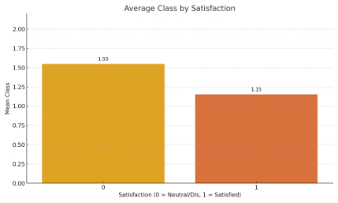
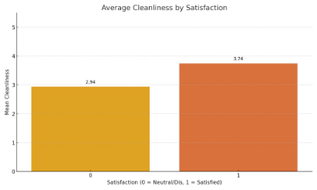
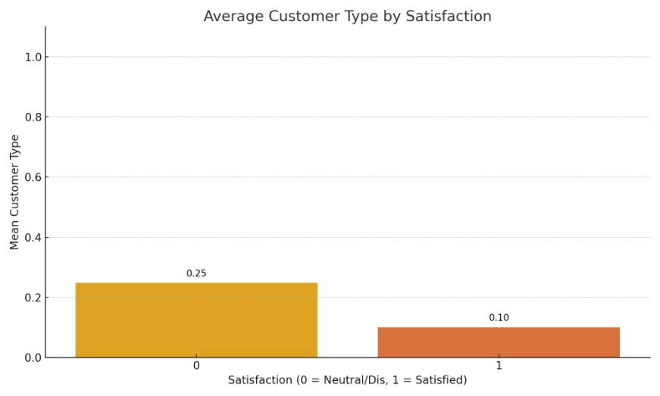
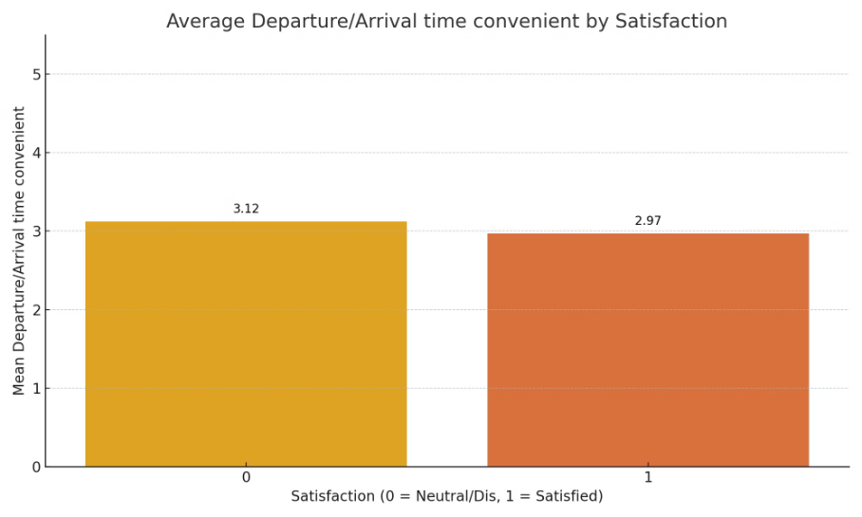
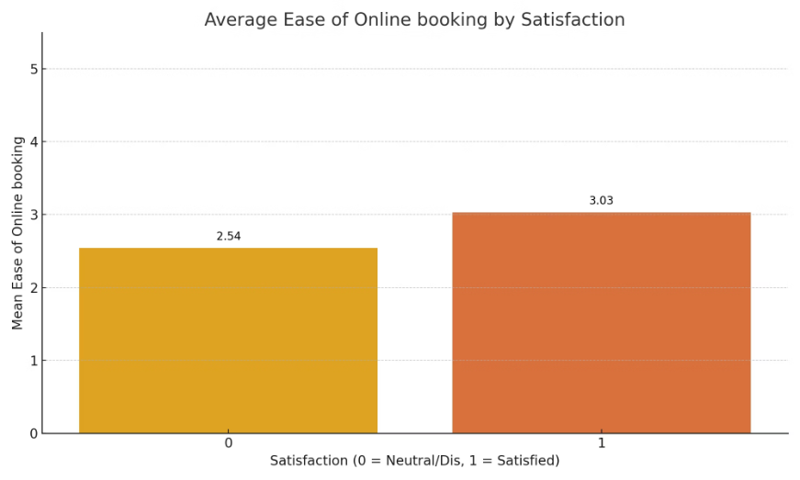
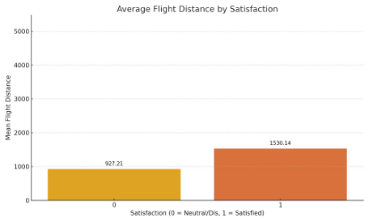
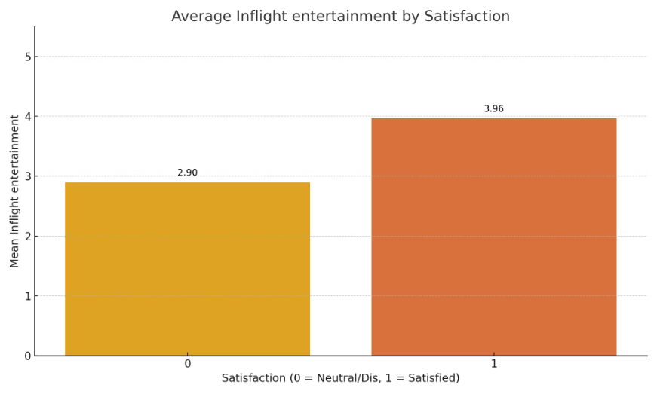
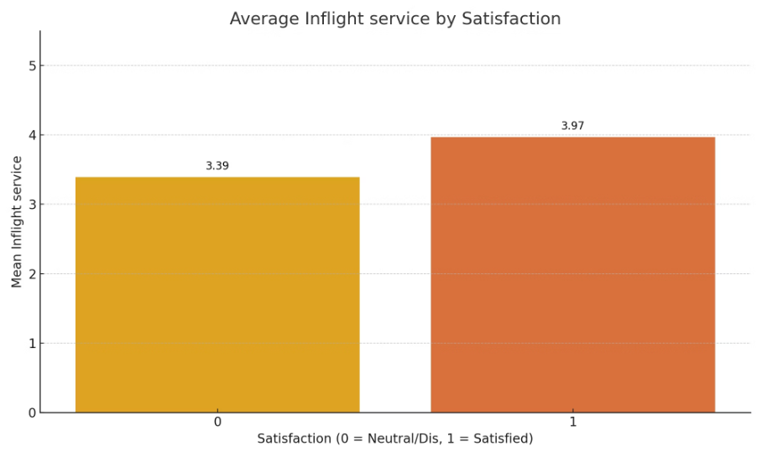


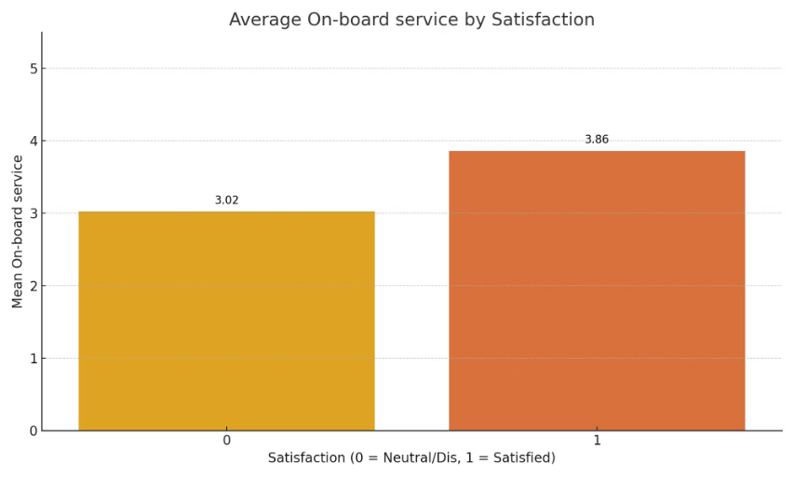
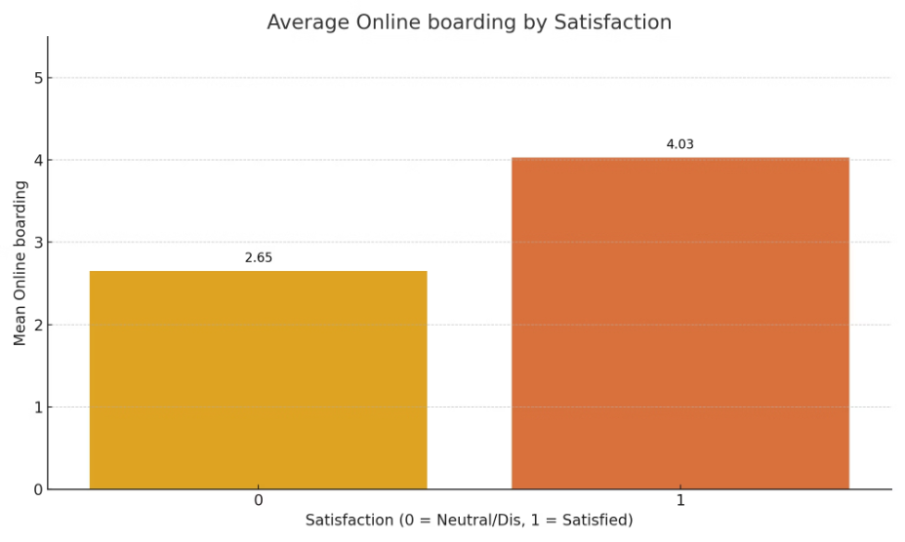
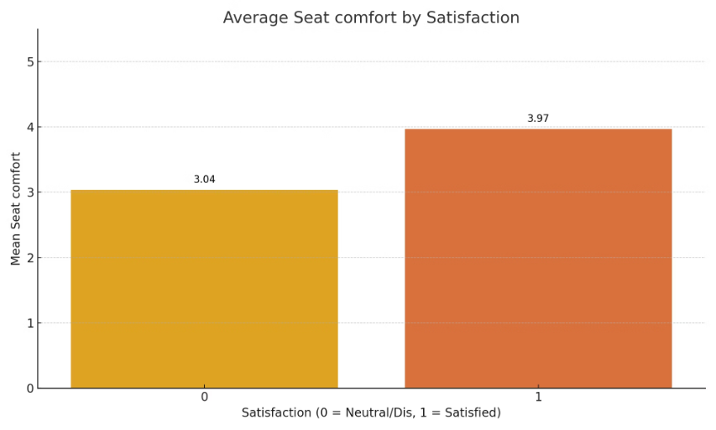
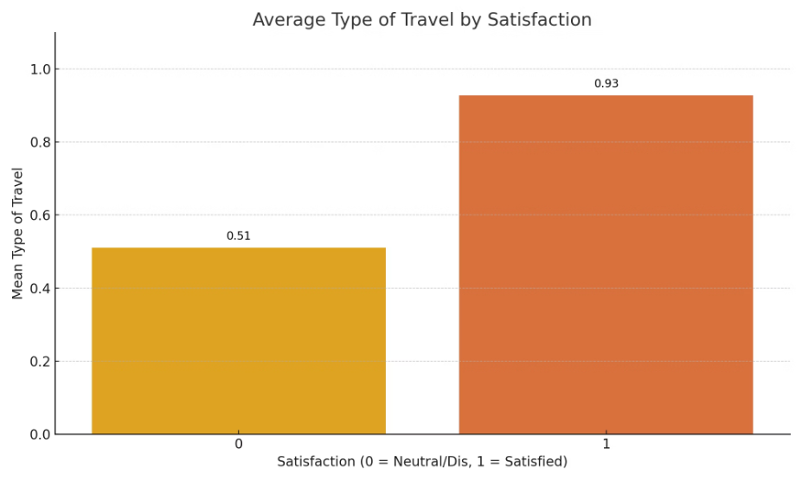

Slide 6


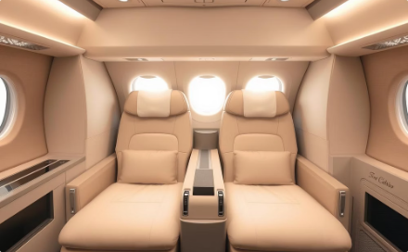
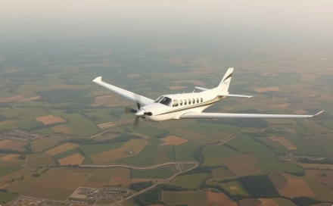
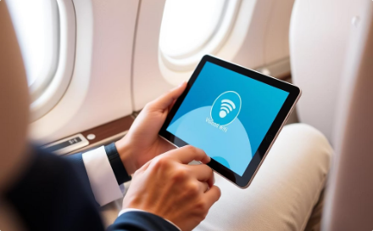

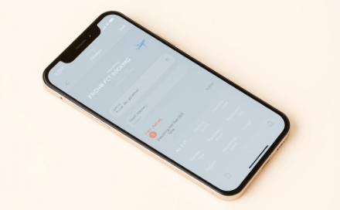
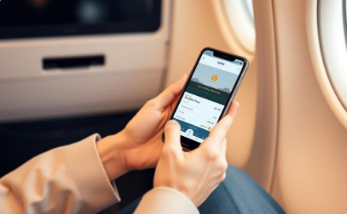
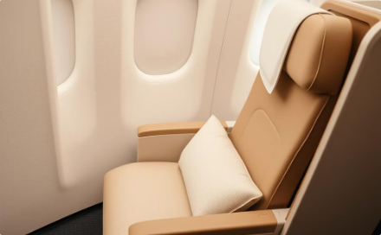
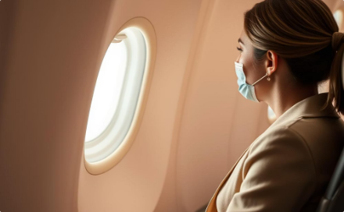
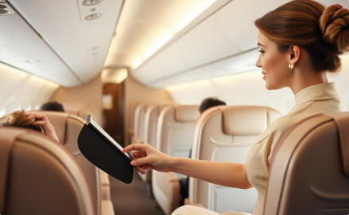
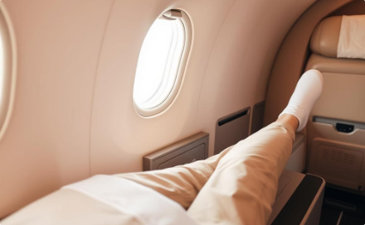
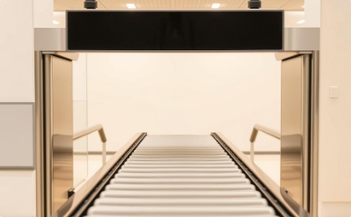
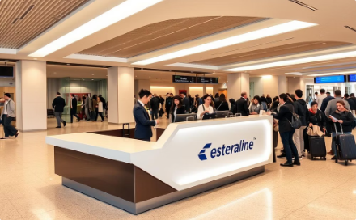

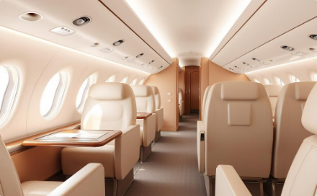


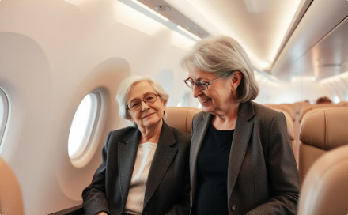
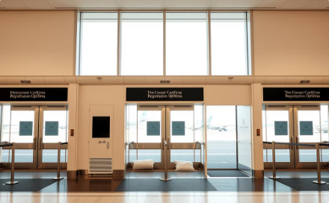
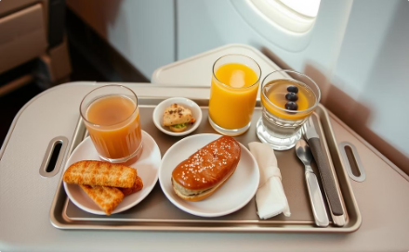
Key Features and Interpretations
Customer Type
Type of Travel
Class
Flight Distance
Frequent flyers tend to be loyal customers
Business travelers show higher satisfaction
Higher class leads to more satisfaction
Longer flights correlate with lower satisfaction
Inflight Wifi Services
Departure/Arrival time convenient
Online Booking
Online Boarding
Better wifi improves satisfaction
Poor timing affects satisfaction
Easy booking boosts satisfaction
Online boarding strongly affects satisfaction
Seat Comfort
Entertainment
On-board Service
Leg Room
Comfortable seats increase satisfaction
Entertainment is valued on long flights
Good service improves experience
Leg space matters for satisfaction
Baggage Handling
Check-in Service
Inflight Staff
Cleanliness
Smooth baggage handling reduces complaints
Efficient check-in boosts experience
Friendly inflight staff matters
Clean environment improves perception
Arrival Delays
Gender Patterns
Age Factors
Gate Location
Delays reduce satisfaction
Passenger satisfaction may vary by gender
Older passengers may value different services
Gate proximity may reduce stress
Food and Drink
Better food increases enjoyment

Slide 7
Modeling and Feature Selection
We used Logistic Regression, Random Forest, and XGBoost models. Feature selection was performed using LASSO combined with SMOTE and Random Undersampling to balance the dataset.
XGBoost consistently outperformed others, achieving the highest AUC and balanced metrics. Logistic Regression was stable but less powerful, while Random Forest showed slight overfitting.
Logistic Regression
Random Forest
XGBoost
Simple and stable, slightly weaker performance
Strong but with some overfitting tendencies
Best performance with highest AUC and balanced metrics

Slide 8
Model Performance Evaluation
XGBoost achieved the highest accuracy of 96.2% and an AUC of 0.995, outperforming other models. Evaluation metrics included Accuracy, Precision, Recall, and AUC to ensure robust assessment.
LASSO-selected features proved critical in refining model predictions and guiding actionable insights.
Accuracy
AUC
Key Features
XGBoost reached 96.2% accuracy
XGBoost scored 0.995, indicating excellent discrimination
Customer Type, Type of Travel, Online Boarding, Wifi Service

Slide 9





Actionable Recommendations
Based on SMOTE LASSO feature analysis, ten recommendations aim to enhance passenger satisfaction. These include improving online boarding, upgrading inflight wifi, and focusing on business travelers' needs.
Other suggestions involve enhancing seat comfort, check-in services, cleanliness, minimizing delays, and simplifying online booking.
Improve Online Boarding
Smooth digital boarding process increases satisfaction
Upgrade Inflight Wifi
Enhance speed and stability, especially on long flights
Focus on Business Travelers
Customize services like faster check-in and quieter zones
Enhance Seat Comfort
Invest in ergonomics and legroom

Slide 10

Further Recommendations and References
Additional recommendations include strengthening check-in and onboard services, maintaining cleanliness, proactively minimizing arrival delays, and personalizing offers for loyal customers.
Check-in & On-board Services
Automate kiosks and improve staff training
Cleanliness
Increase cleaning frequency, especially during delays
Minimize Arrival Delays
Communicate proactively and offer compensation
Personalized Offers
Target loyal and disloyal customers differently

Slide 11
Thank You for Your Attention
We appreciate your time and interest in our Airline Passenger Satisfaction Project.
Looking forward to your questions and next steps to enhance passenger experience.
Questions Welcome
We're here to clarify and discuss insights in detail.

